Slide 1

TR Bees
Taste Not Waste

Slide 2
Meet the TR Bees!
Manchester bees: busy bees, worker bees - symbolic of resilience and a strong work ethic.
We are the Tech Returner Bees
Helen Leila Sarah Tania

Slide 3
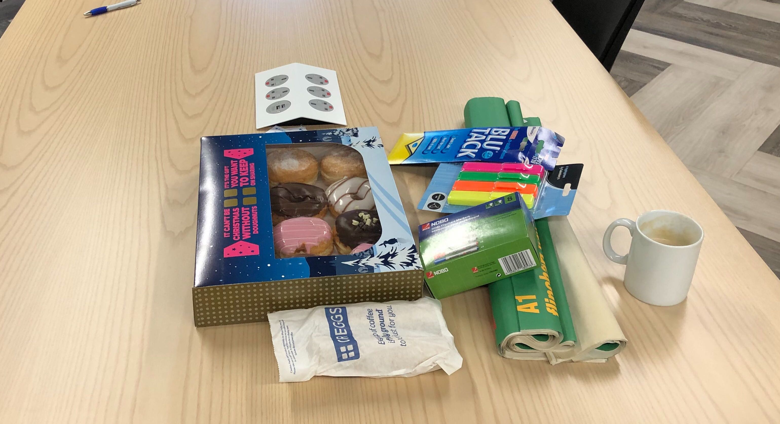
Kick off: Initial planning meeting
Important things first: team name!
Listed ideas we considered and how we came up with them
Debated merits of various project ideas over coffee and doughnuts then made shortlist of two.

Slide 4
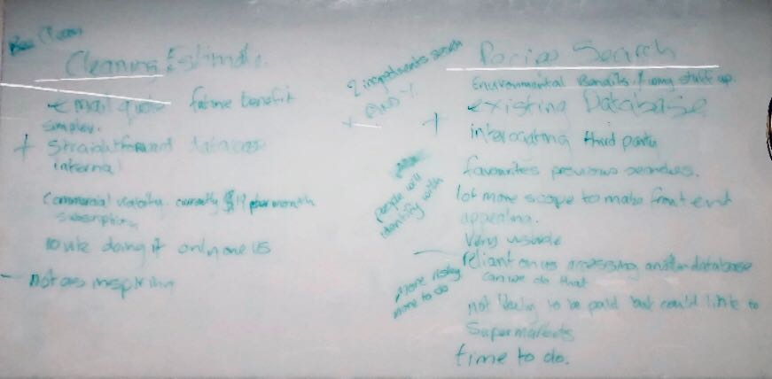
Bee Clean vs Recipe app

Slide 5
The Decision
Would it showcase enough of our skills?
Commercial viability
Ease of build
Safe option vs challenging ourselves
Options for phased delivery
The winner: Recipe app!

Slide 6
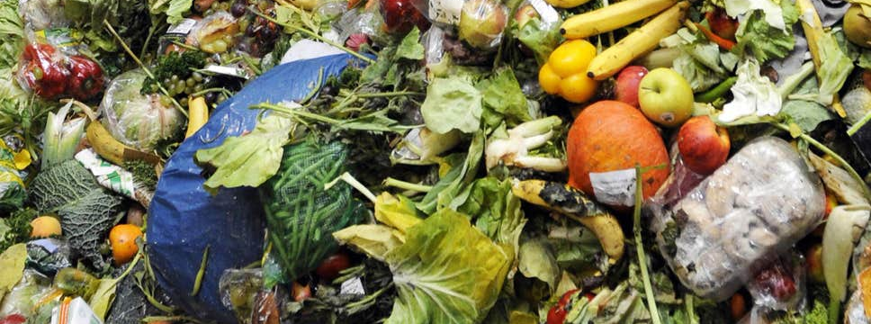
The Problem: Food Waste
Mjnkjnk
1/3 of all food produced globally goes to waste
7 million tonnes of that waste is created by households.
Average family of four could save £70 per month by reducing their food waste.

Slide 7
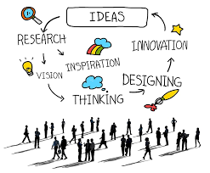
The Solution:
“Taste Not Waste” app
There are many things that can be done to reduce food waste, but our project focuses on:
Meal planning
Using up leftovers you already have at home.
Why did we choose this issue?
Market research on social media
Using up food is a current issue / on peoples' minds
Saving the planet and saving money = win win situation!
Type to enter a caption.

Slide 8
How
We quickly assigned responsibilities (based on personal preference), 2 on backend, 2 on frontend.
Communication was done mostly via Slack with some physical meet ups (with cookies) at Eagle Labs, Leila’s house and coffee shops.
The first step was ensure that a third party recipe API we had found (Edamam) would allow us to deliver something.
We built a proof of concept in React that accessed Edamam successfully - great - now fully committed to our idea!
Frontend could now progress with their design, meanwhile the backend team carried out a quick study on other APIs to make sure we were using the most appropriate one for our needs.
It was also important to show that we could create a database and build an API to access that so the backend team worked on that aspect.

Slide 9
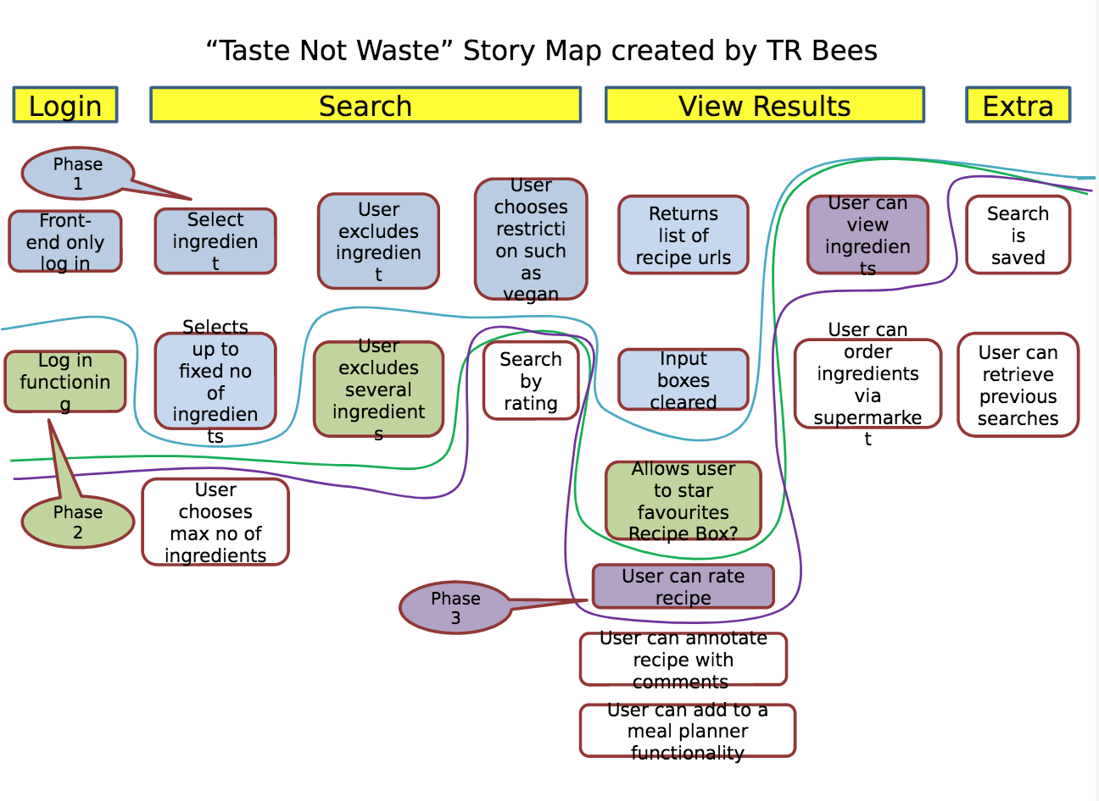
Type to enter a caption.

Slide 10
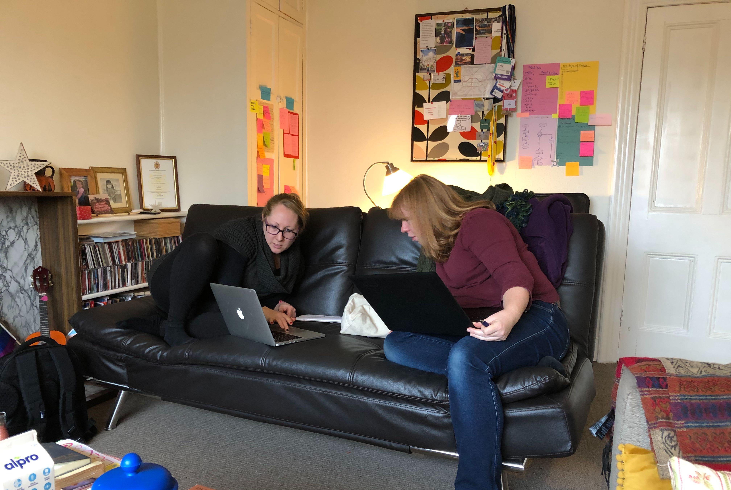
Collaborative working at Leila’s house before Christmas

Slide 11
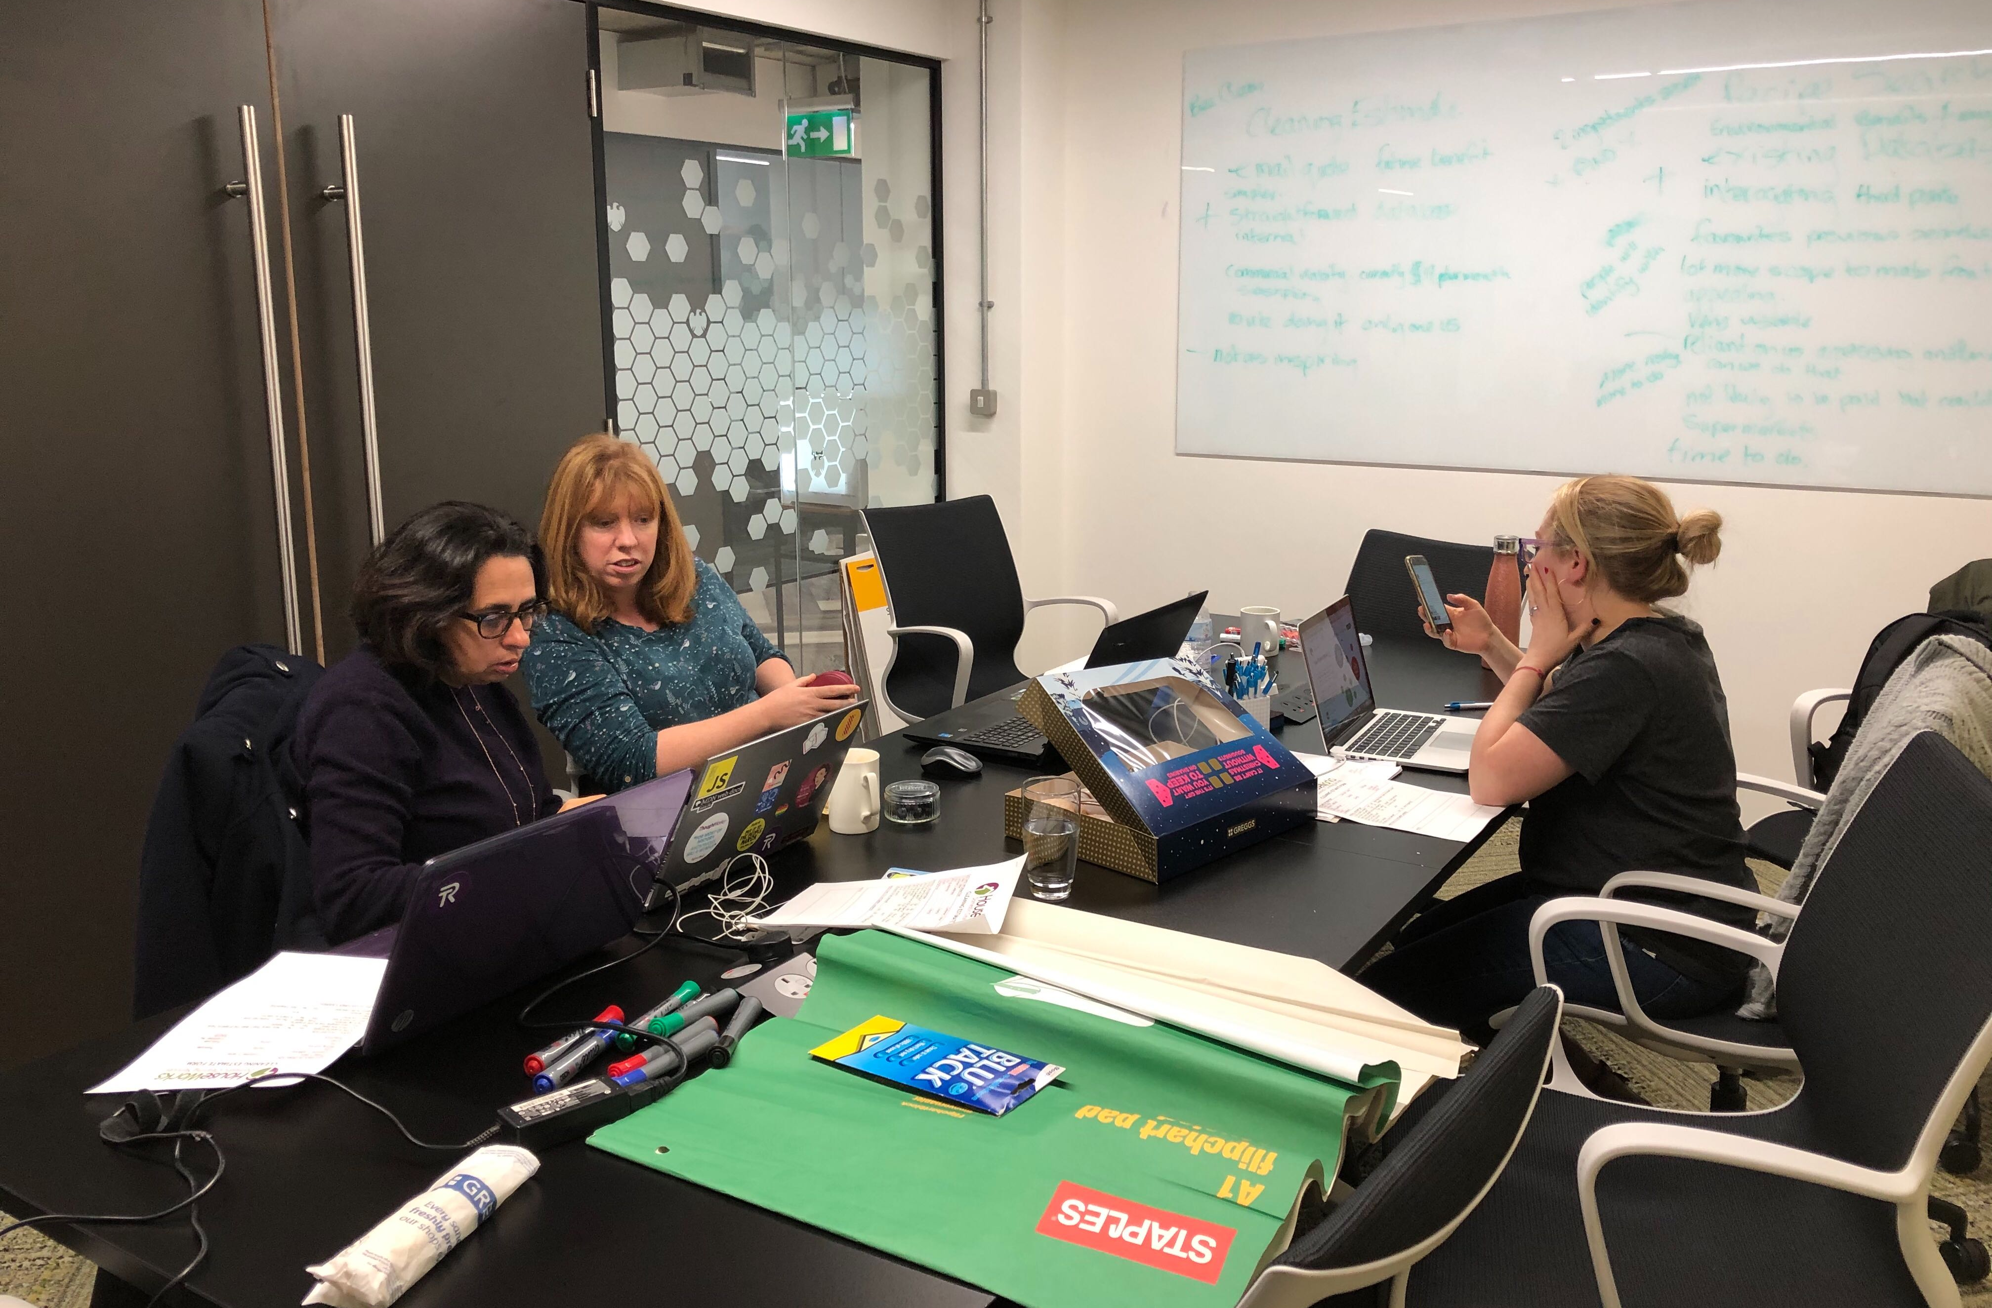
Checking out API’s for our recipe app @ Eagle Labs

Slide 12
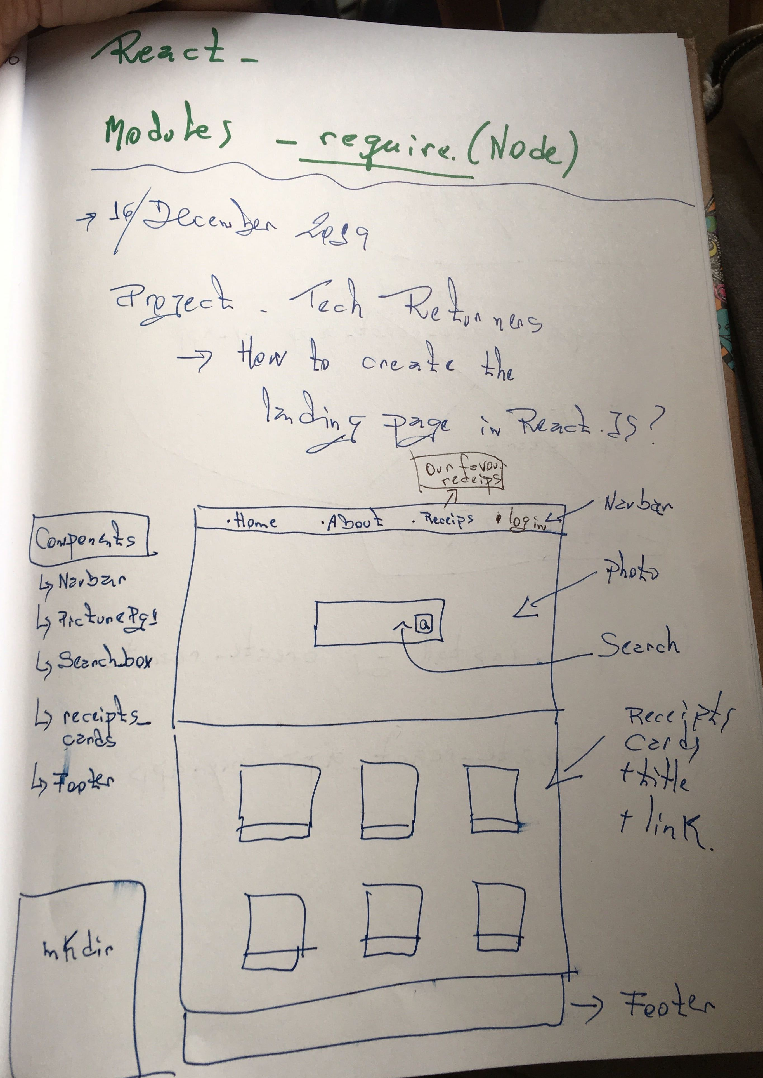
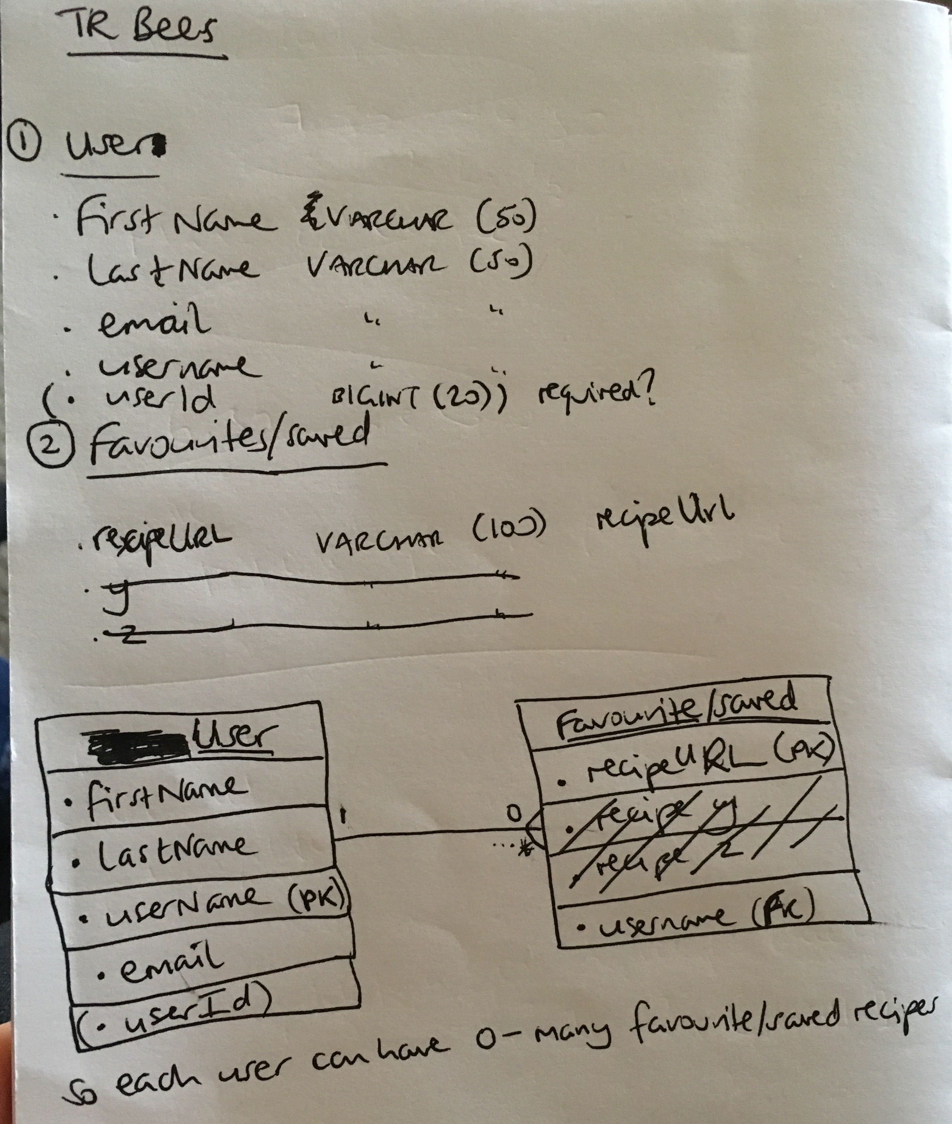
Sketching out our app and database
Type to enter a caption.
Type to enter a caption.

Slide 13
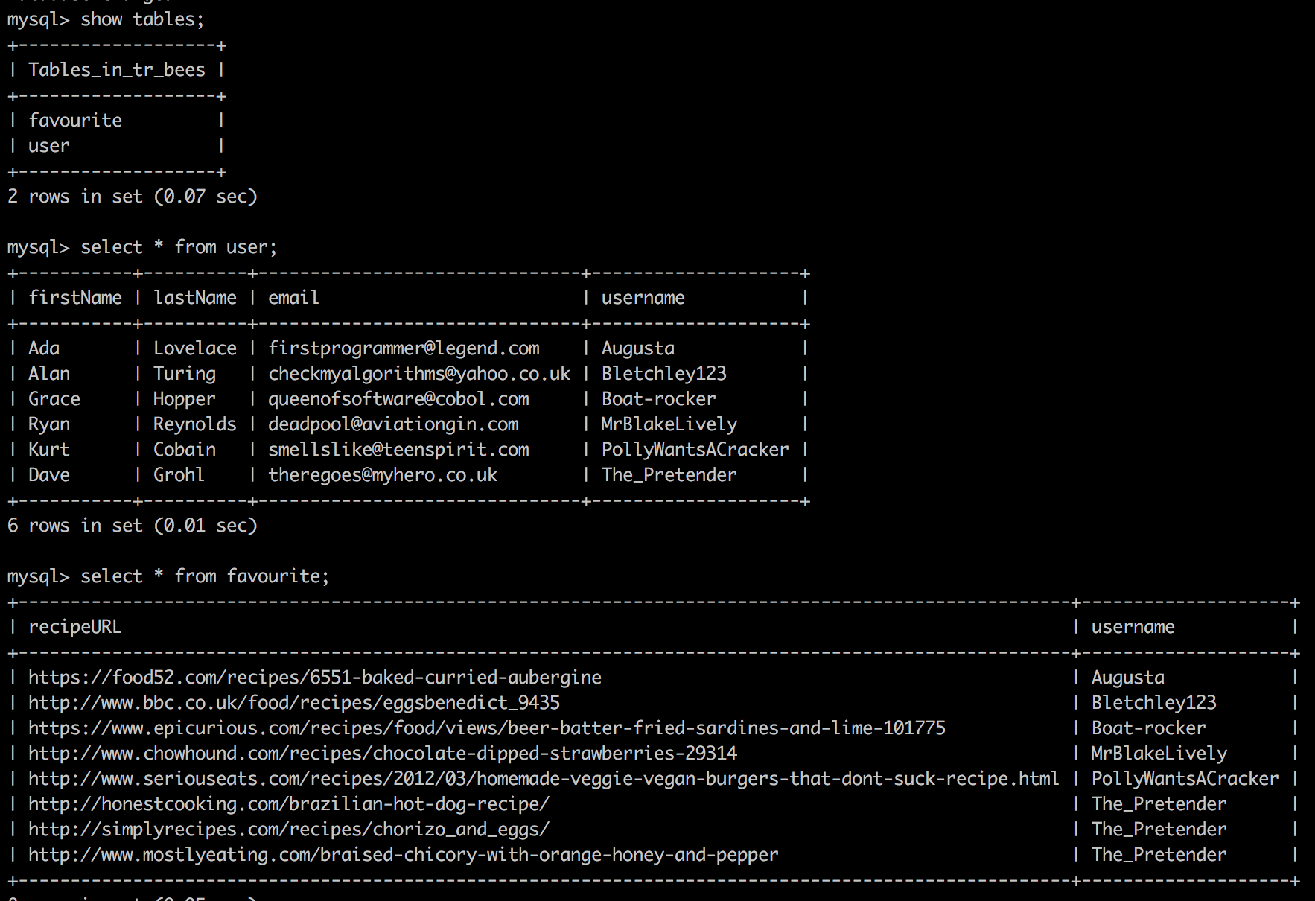
Database
Type to enter a caption.

Slide 14
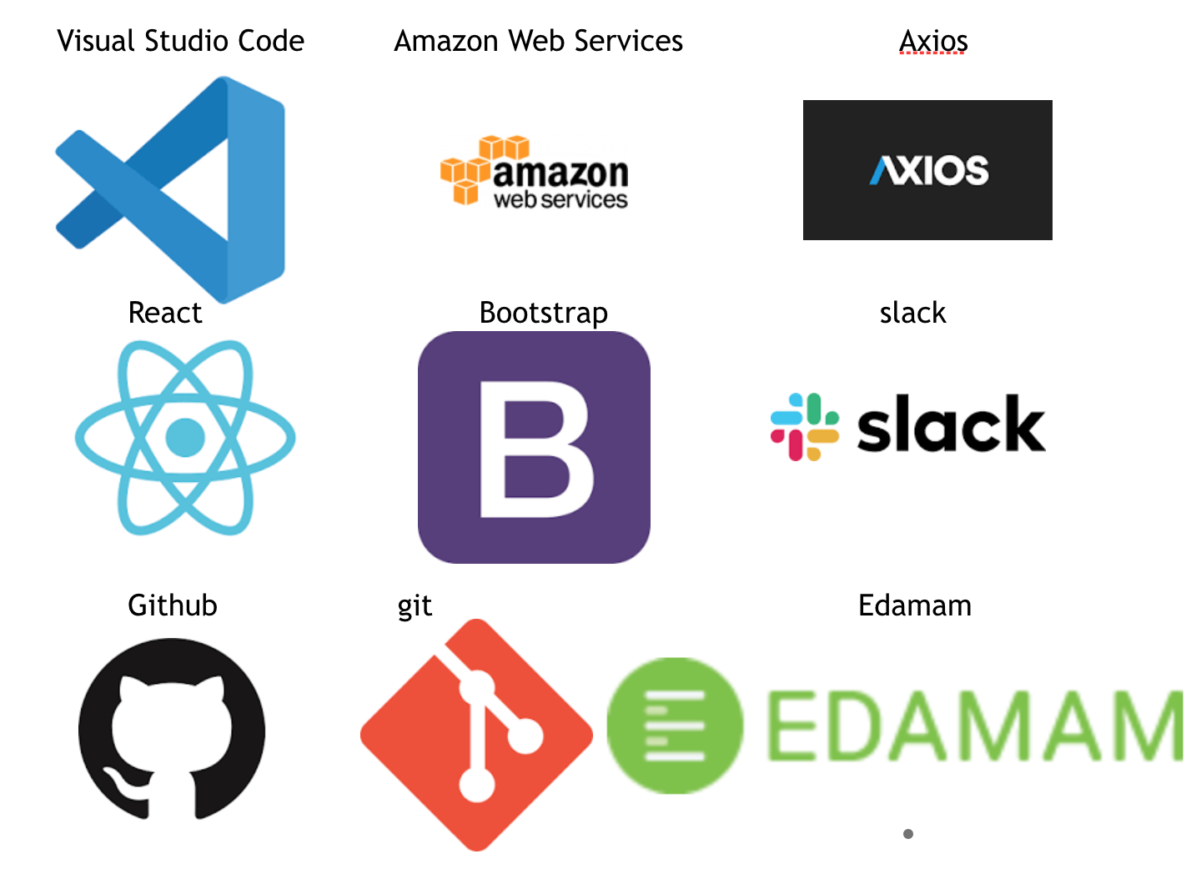
Tools we used
Type to enter a caption.

Slide 15
Challenges
Trying to work over Christmas/around work/family commitments/holidays was difficult for all of us.
Communication within the frontend/backend teams and general whole team communication could have been more consistent.
Using a third party API wasn’t something we’ve covered as part of the TR course but we managed to incorporate it.
Perhaps should have had a designated Project Manager.

